Slide 1
Mobility Services
We are at your service!
01/29/2024

Slide 2
Contents
Commuting to campus
Getting around campus
Parking
Carpools & Vanpools
Public Transportation
Biking

Slide 3
Parking Permits for Employees

Slide 4
Parking Permits for Employees
Apply online for a parking permit or contact the Parking Services Office at (412) 624-4034.
When you apply for a permit, you may select up to three different parking facilities as possible choices.
You will be added to the waitlist.
Employees use automatic pre-tax, payroll deductions
Indoor garages: $106/month
Outdoor lots: $98/month
Electric vehicles: $115/month

Slide 5
Parking Permits for Employees
GN permits are available to employees who work shifts:
2 PM - $78/month
3 PM - $65/month
5 PM - $60/month
Motorcycle permit - $29/semester
Prices are subject to change.

Slide 6
Shared Permits
Can be shared between 2-3 people for a specific parking location. Only one of the permit holders may have a vehicle in their designated parking location at a time.
The cost of the permit will be divided by the number of parkers sharing the permit.
Currently only offered at Soldiers and Sailors, OC, RA, A,
and CC (Craig Hall). Must be a current permit holder for this program.
Visit pts.pitt.edu/shared-and-set-day-permits to learn more and request a Shared or Set-Day permit.

Slide 7
Shared Permits
Allows you to park in your designated parking location on specific, set days.
These permits will be offered based on the number of set days per week (either 2 or 3 days) that you are scheduled on campus.
Currently only offered at Soldiers and Sailors, OC, RA, A,
and CC (Craig Hall). Must be a current permit holder for this program.
Visit pts.pitt.edu/shared-and-set-day-permits to learn more and request a Shared or Set-Day permit.

Slide 8
Cash Parking on Campus

Slide 9
Cash Parking on Campus
Cash parking is available on a first come, first serve basis.
Garage:
Soldiers & Sailors (Lower Campus)
Hourly rate (varies) until 4:00 PM – evening rate is $5.00 after 4:00 PM
Outdoor Lots
OC Lot (Upper Campus)
$7.00 all day rate with Pitt ID
$15.00 all day rate without Pitt ID
Evening rate is $5.00 after 4:00 PM
Panther Hollow (Lower Campus) – $5.00 daily rate
Rates are Subject to Change

Slide 10
ParkMobile Parking on Campus

Slide 11
Cash Parking on Campus
Hourly and daily parking is available with ParkMobile on the ParkMobile website or app.
Same-day contact-less payment reservations with ParkMobile are available for University faculty, staff, and students at the following campus garages and lots:
Rates are subject to change.
Visit pts.pitt.edu/mobility/parking/parkmobile to learn more and explore all ParkMobile locations.
Posvar (A) Garage: $7.78 | OC Lot: $7.78
U Lot: $11.11 | RA Lot: $11.11
PH Lot: $5.00

Slide 12
Motorist Assistance Program (MAP)

Slide 13
Motorist Assistance Program (MAP)
If your vehicle needs a jump start or if you've locked your keys inside, MAP is here for you!
During business hours (M-F 8:00 AM – 4:00 PM) please call the Parking Services Office at (412) 624-4034.
After 4:00 PM contact Campus Police at (412) 624-2121.

Slide 14
Carpooling

Slide 15
Carpooling
Carpooling to campus in a personal vehicle with 1 to 4 coworkers is an eco-friendly commute option that saves you money!
There are two ways to register your carpool:
Pitt Parking Services Office: Commute together at least 3 days a week, one member of the carpool must be a permit holder with the Parking Services Office.
CommuteInfo: Commute together at least 2 days a week.

Slide 16
Vanpooling
Vanpools consist of groups of 5-15 participants who live near each other or along the same route and share a ride to Oakland in either an SUV, minivan, or economy van. Participants split the cost of commuting, so this option is affordable and sustainable!
Registered vanpoolers receive the following benefits:
Free parking for registered vanpools provided by the Office of Mobility
Free ride matching services
Pre-tax payroll deduction
Temporary parking permits for when members need to drive separately (2 per semester)
Emergency Ride Home Reimbursement Program

Slide 17
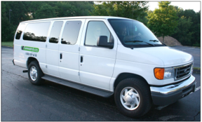
Vanpooling
To join a vanpool, visit Commute with Enterprise's website and click "Join Commute." CommuteInfo and Commute with Enterprise will contact you with the next steps.
Contact commuting@bc.pitt.edu to learn more about the CommuteInfo vanpool program in partnership with Commute with Enterprise.

Slide 18
Bus, Light Rail, and Incline

Slide 19
Bus, Light Rail, and Incline
Ride Pittsburgh Regional Transit (PRT) fare-free using your active Pitt ID.
PRT provides transportation around Oakland and Pittsburgh seven days a week, including limited service on holidays.
Routes and schedules are available online for all PRT options.
Access real-time routes and nearby lines using the Transit App.
Learn more about public transportation options at pts.pitt.edu/mobility/public-transportation.

Slide 20
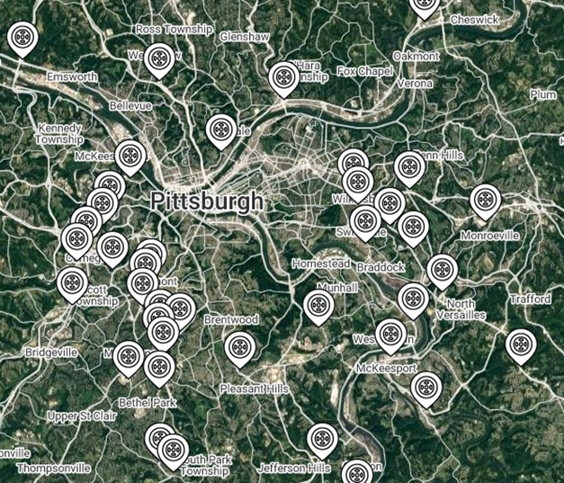
Park-n-Ride
Park-n-Ride facilities are located throughout the region. These are places where you can park your car to meet your bus, carpool or vanpool buddies.
Be sure to check in advance for bus arrival times or any parking restrictions.
Regional listing available: https://commuteinfo.org/for-commuters/park-ride-locator/

Slide 21
Biking

Slide 22
Biking
Biking to campus is a sustainable choice that incorporates movement into your day, boosts personal wellness, and strengthens community.
Explore our Campus Bike Map to find free, convenient bike parking locations or Fixit Bike Repair stations equipped with an air pump and tools.
Secure your bike in a bike locker or indoor bike room on campus.
Locker rentals are $40/semester + a $10 refundable key deposit.
Register your bike for free with the Pitt BikeIndex to record your ownership in the case of theft or impoundment.

Slide 23
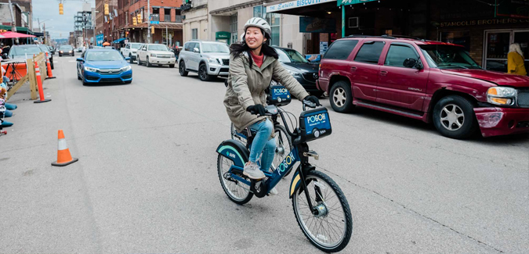
Biking
No bike? No worries! All faculty, staff, & students can use POGOH, Pittsburgh's bike-sharing system, for free! Enjoy unlimited 30-minute rides on either standard or electric-assist bikes once you activate your benefit.
Learn more about biking on campus and safety tips at www.pts.pitt.edu/mobility/biking

Slide 24
Campus Shuttles

Slide 25
Shuttles
Shuttle Ride for Free with your Pitt ID!
Campus Shuttle System
Route times and locations for our shuttles can be found at pts.pitt.edu/mobility/shuttle-services/pitt-shuttle-schedule
All shuttles offer real-time route tracking via the Pitt Shuttle Tracker for desktop users or TransLoc App for mobile users.

Slide 26
Shuttles
SafeRider
Provides complimentary transportation from 9:00 PM to 3:00 AM when special non-emergency needs arise for Pitt students, faculty, and staff.
You can request SafeRider from your phone with the TransLoc App or call 412-648-CALL (2255) for your safe ride.
Each rider is permitted 1 round trip per evening and a maximum of 25 trips per semester.
You are allowed 2 non-University guests.

Slide 27
Shuttles
Disability Shuttle
Provides safe, convenient transportation for students, faculty, and staff with temporary injuries and permanent disabilities.
All rides must be within the Disability Shuttle/SafeRider boundaries.
To determine if your rides are within the designated boundaries, please submit the Disability Shuttle Eligibility Form.
Contact Disability Resources and Services at (412) 628-7890 if you have any questions.

Slide 28
Questions?
Mobility Services is here to help!
Phone: 412-624-4034
Email: Parking@bc.pitt.edu
Commuting@bc.pitt.edu
Website: pts.pitt.edu
@PittMobility
@PittMobility
@PittMobility

Slide 29
Thank You!

